Slide 1
The Look Of Love
The Corinthian Correction

Slide 2
An Unhealthy Relationship With God
I was taught to live transactionally or functionally with God.
I thought that if I did the right things for God, He would do the right things for me.
I put so much emphasis doing that there was little room for a loving relationship with God in Christ Jesus.
I literally could preach, teach and sing about love, and call others to love God, but for me, it was all part of a transaction, doing the things I was supposed to do so God would too.
There has been so much “love talk at church” while there has been too much “hate talk at home.”

Slide 3
A God-Shaped Love
1 John 4:9-10 (NIV)
This is how God showed his love among us: He sent his one and only Son into the world that we might live through him. This is love: not that we loved God, but that he loved us and sent his Son as an atoning sacrifice for our sins.

Slide 4
The Second Incarnation
Incarnation = to put in the form of flesh
Jesus = the first incarnation of God. God in flesh.
He was Immanuel, God with us. (Matthew 1:23)
The church = “the second incarnation” of Jesus
God lives in us. We are “the body of Christ,” in the world. The world is to see God in us.
1 John 4: 11-12, Dear friends, since God so loved us, we also ought to love one another. No one has ever seen God; but if we love one another, God lives in us and his love is made complete in us.

Slide 5
Do People Experience God Through Me?
1 John 4:13-21 (NIV)
¹³ We know that we live in him and he in us, because he has given us of his Spirit. ¹⁴ And we have seen and testify that the Father has sent his Son to be the Savior of the world. ¹⁵ If anyone acknowledges that Jesus is the Son of God, God lives in him and he in God. ¹⁶ And so we know and rely on the love God has for us. God is love. Whoever lives in love lives in God, and God in him.

Slide 6
In this way, love is made complete among us so that we will have confidence on the day of judgment, because in this world we are like him. ¹⁸ There is no fear in love. But perfect love drives out fear, because fear has to do with punishment. The one who fears is not made perfect in love. ¹⁹ We love because he first loved us. ²⁰ If anyone says, "I love God," yet hates his brother, he is a liar. For anyone who does not love his brother, whom he has seen, cannot love God, whom he has not seen. ²¹ And he has given us this command: Whoever loves God must also love his brother.

Slide 7
Too Much Hate Talk
Too often Republicans hate the Democrats and Democrats hate the Republicans.
Too often Whites hate the Blacks and Blacks hate the Whites.
Too often Rich hate the Poor and the Poor hate the rich.
Too often Citizens hate Immigrants and Immigrants hate Citizens.
Too often Christians hate the LGBTQs and LGBTQs hate Christians
Too often Jews hate Arabs and Arabs hate Jews.

Slide 8
John Has Strong Words About Hate
1 John 3:11-15 (NIV)
This is the message you heard from the beginning: We should love one another. ¹² Do not be like Cain, who belonged to the evil one and murdered his brother. And why did he murder him? Because his own actions were evil and his brother's were righteous. ¹³ Do not be surprised, my brothers, if the world hates you. ¹⁴ We know that we have passed from death to life, because we love our brothers. Anyone who does not love remains in death. ¹⁵ Anyone who hates his brother is a murderer, and you know that no murderer has eternal life in him.

Slide 9
Expressions of a Failure to Love.
It speaks out of the absence of relationship of affection with the Father and His Son Jesus Christ.
It is highly possible to “say right” and “do right” without “being right.”
That’s why Jesus makes such a big deal of learning to “love right.”
Unless we first love God, we will never be able to love others the way He wants to.

Slide 10
What Does Scripture Record As The First Thing God Ever Did?

Slide 11
What God Did First?
Revelation 13:8 (NIV)
All inhabitants of the earth will worship the beast--all whose names have not been written in the book of life belonging to the Lamb that was slain from the creation of the world.
1 Peter 1:18-20 (NIV)
¹⁸ For you know that it was not with perishable things such as silver or gold that you were redeemed from the empty way of life handed down to you from your forefathers, ¹⁹ but with the precious blood of Christ, a lamb without blemish or defect. ²⁰ He was chosen before the creation of the world, but was revealed in these last times for your sake.

Slide 12
Ephesians 1:4-6 (NIV)
For he chose us in him before the creation of the world to be holy and blameless in his sight. In love ⁵ he predestined us to be adopted as his sons through Jesus Christ, in accordance with his pleasure and will-- ⁶ to the praise of his glorious grace, which he has freely given us in the One he loves.
Titus 1:2 (NIV)
“…a faith and knowledge resting on the hope of eternal life, which God, who does not lie, promised before the beginning of time,…”
John 17:24 (NIV)
"Father, I want those you have given me to be with me where I am, and to see my glory, the glory you have given me because you loved me before the creation of the world.

Slide 13
God’s Plan to Save the World
Exists
Because God Loved First.
1 John 4:11 (ESV)
Beloved, if God so loved us, we also ought to love one another.

Slide 14
The New Testament
Reveals A Striking Contrast
To The Idea Of
Love First.

Slide 15
The Church of God At Corinth
1 Corinthians 1:1-3 (NIV)
¹ Paul, called to be an apostle of Christ Jesus by the will of God, and our brother Sosthenes, ² To the church of God in Corinth, to those sanctified in Christ Jesus and called to be holy, together with all those everywhere who call on the name of our Lord Jesus Christ--their Lord and ours: ³ Grace and peace to you from God our Father and the Lord Jesus Christ.

Slide 16
1 Corinthians 1:4-9 (NIV)
⁴ I always thank God for you because of his grace given you in Christ Jesus. ⁵ For in him you have been enriched in every way--in all your speaking and in all your knowledge-- ⁶ because our testimony about Christ was confirmed in you. ⁷ Therefore you do not lack any spiritual gift as you eagerly wait for our Lord Jesus Christ to be revealed. ⁸ He will keep you strong to the end, so that you will be blameless on the day of our Lord Jesus Christ. ⁹ God, who has called you into fellowship with his Son Jesus Christ our Lord, is faithful.

Slide 17
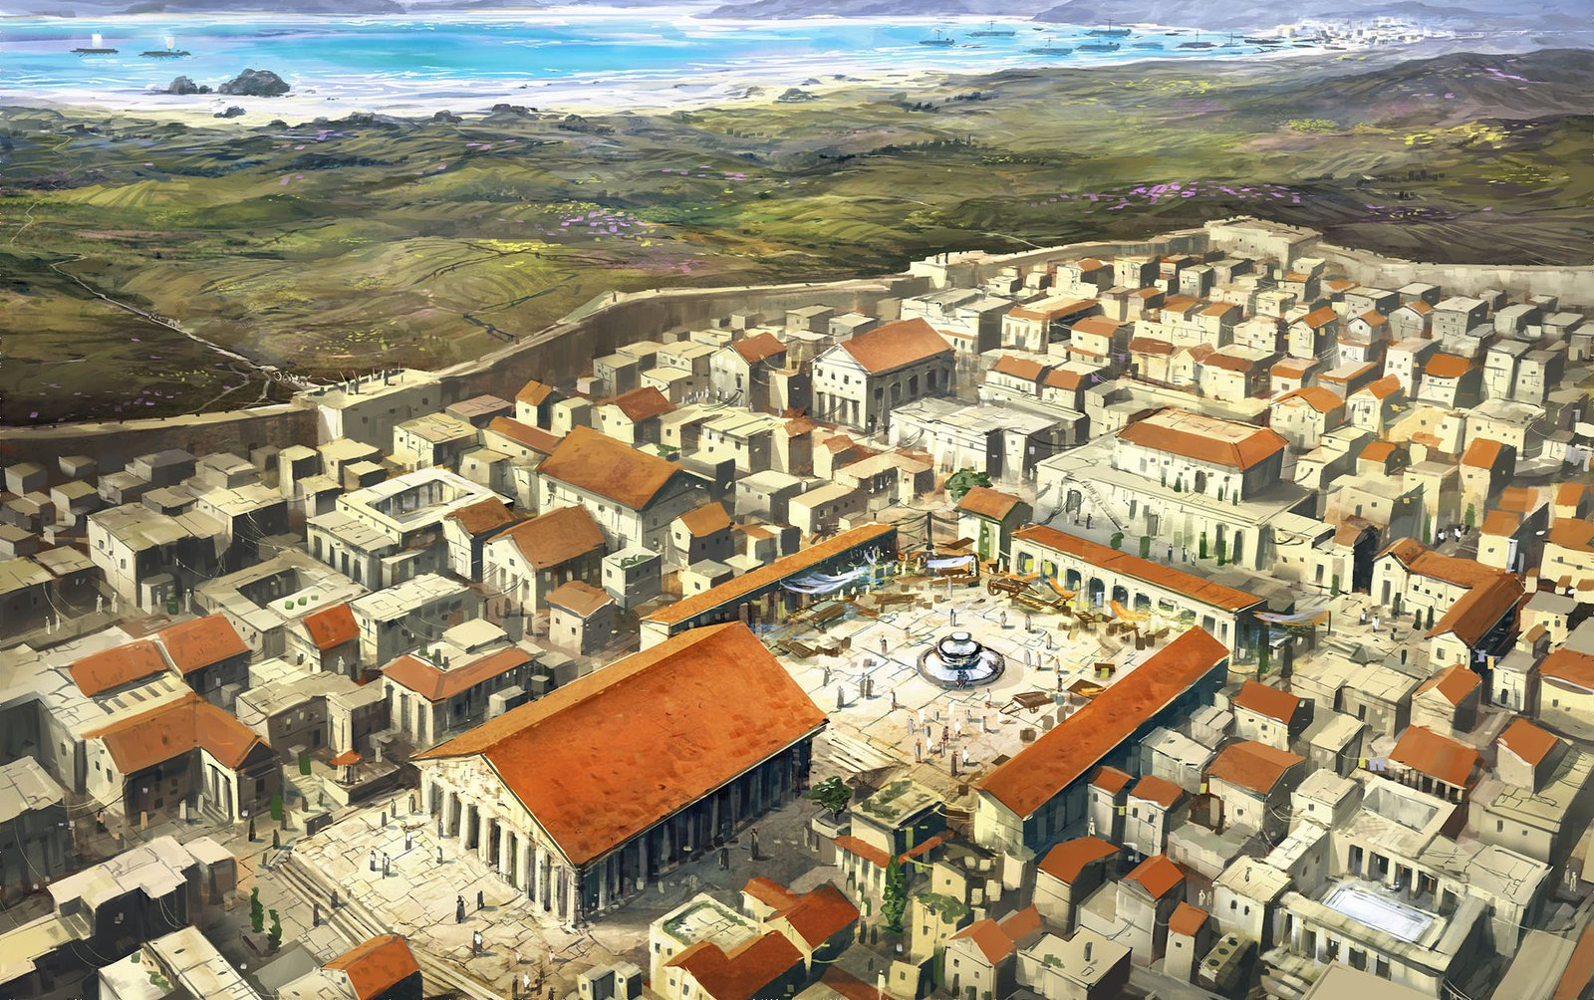

Slide 18
Corinth
A Troubled City
With a Troubled Church

Slide 19
The Corinthian Mess
Division
Moral Decay
Fraud
Envy
Jealousy
Idol Worship
Slander
Arrogance
1 Corinthians 5:1 (NIV)
It is actually reported that there is sexual immorality among you, and of a kind that does not occur even among pagans: A man has his father's wife.

Slide 20
Their Choices Reflected An Ungodly Approach to Relationships
Rather than use their gifts to bless they used them to get an advantage, to drop names, get the inside track.
Rather than bless they cursed
Rather than sacrifice they sued
Rather than commune they consumed
Rather than support they slandered

Slide 21
Paul’s Corinthian Correction was to
Teach Them How to Love!

Slide 22
1 Corinthians 13:1-13 (NIV)
If I speak in the tongues of men and of angels, but have not love, I am only a resounding gong or a clanging cymbal. ² If I have the gift of prophecy and can fathom all mysteries and all knowledge, and if I have a faith that can move mountains, but have not love, I am nothing. ³ If I give all I possess to the poor and surrender my body to the flames, but have not love, I gain nothing. is love.

Slide 23
⁴ Love is patient, love is kind. It does not envy, it does not boast, it is not proud. ⁵ It is not rude, it is not self-seeking, it is not easily angered, it keeps no record of wrongs. ⁶ Love does not delight in evil but rejoices with the truth. ⁷ It always protects, always trusts, always hopes, always perseveres. ⁸ Love never fails. But where there are prophecies, they will cease; where there are tongues, they will be stilled; where there is knowledge, it will pass away. ⁹

Slide 24
For we know in part and we prophesy in part, ¹⁰ but when perfection comes, the imperfect disappears. ¹¹ When I was a child, I talked like a child, I thought like a child, I reasoned like a child. When I became a man, I put childish ways behind me. ¹² Now we see but a poor reflection as in a mirror; then we shall see face to face. Now I know in part; then I shall know fully, even as I am fully known. ¹³ And now these three remain: faith, hope and love. But the greatest of these

Slide 25
Next Week We Start Unpacking Paul’s Description of Love,
How it Applied to Them
And
How it Applies to Us.

