Slide 1
Authority and knowledge of the bible
#1 we need to know the word of god
#2 having authority

Slide 2
Luke 4:31-37
³¹ And he went down to Capernaum, a city of Galilee. And he was teaching them on the Sabbath, ³² and they were astonished at his teaching, for his word possessed authority. ³³ And in the synagogue there was a man who had the spirit of an unclean demon, and he cried out with a loud voice,
^{Verse 32 parallel}
²² And they were astonished at his teaching, for he taught them as one who had authority, and not as the scribes.

Slide 3
Luke 4:31-37
³⁴ “Ha! What have you to do with us, Jesus of Nazareth? Have you come to destroy us? I know who you are—the Holy One of God.” ³⁵ But Jesus rebuked him, saying, “Be silent and come out of him!” And when the demon had thrown him down in their midst, he came out of him, having done him no harm.

Slide 4
Luke 4:31-37
³⁶ And they were all amazed and said to one another, “What is this word? For with authority and power he commands the unclean spirits, and they come out!” ³⁷ And reports about him went out into every place in the surrounding region.
^{Verse 36 parallel}
²⁷ And they were all amazed, so that they questioned among themselves, saying, “What is this? A new teaching with authority! He commands even the unclean spirits, and they obey him.”

Slide 5
My (fake) reference list
Liz says…
Roger says…
Dave says…
Dave says…
Lisa says…
Mercy says…
Dawn says…
Christi says…
Eric says…
Macey says…
Sheila says…
Baby says…

Slide 6
Matthew 19:3-8
³ And Pharisees came up to him and tested him by asking, “Is it lawful to divorce one's wife for any cause?” ⁴ He answered, “Have you not read that he who created them from the beginning made them male and female, ⁵ and said, ‘Therefore a man shall leave his father and his mother and hold fast to his wife, and the two shall become one flesh’?⁶ So they are no longer two but one flesh. What therefore God has joined together, let not man separate.”

Slide 7
Matthew 19:3-8
⁷ They said to him, “Why then did Moses command one to give a certificate of divorce and to send her away?”⁸ He said to them, “Because of your hardness of heart Moses allowed you to divorce your wives, but from the beginning it was not so. ⁹ And I say to you: whoever divorces his wife, except for sexual immorality, and marries another, commits adultery.”

Slide 8
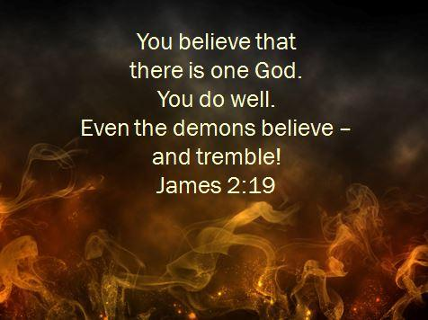

Slide 9
Luke 4:34
“I know who you are—the Holy One of God.”

Slide 10
Luke 4:31-37
³⁴ “Ha! What have you to do with us, Jesus of Nazareth? Have you come to destroy us?

Slide 11
1 John 3:8
The reason the Son of God appeared was to destroy the works of the devil.

Slide 12
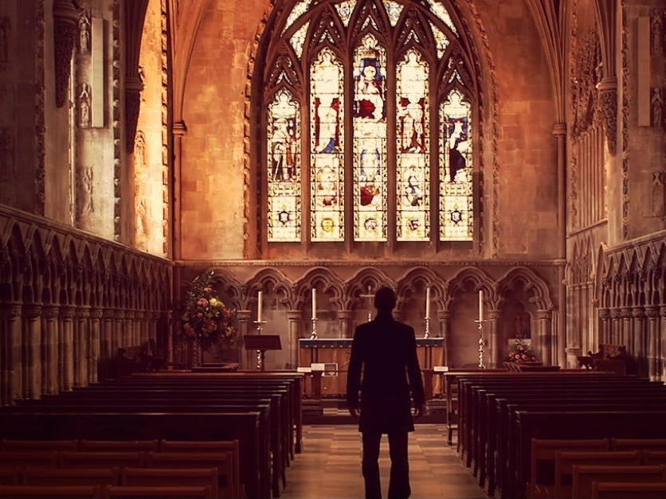

Slide 13



Slide 14


Slide 15


Slide 16

What does Jesus want you to do?

